Slide 1


GATE project - Teachers Training Programme to Support Gifted and Talented Students
Project N°: 2021-1-LT01-KA220-SCH-000027713
Project period 01.01.2022 - 31.12.2023
Programme: Erasmus+ KA220
Cooperation partnership in school education

Slide 2
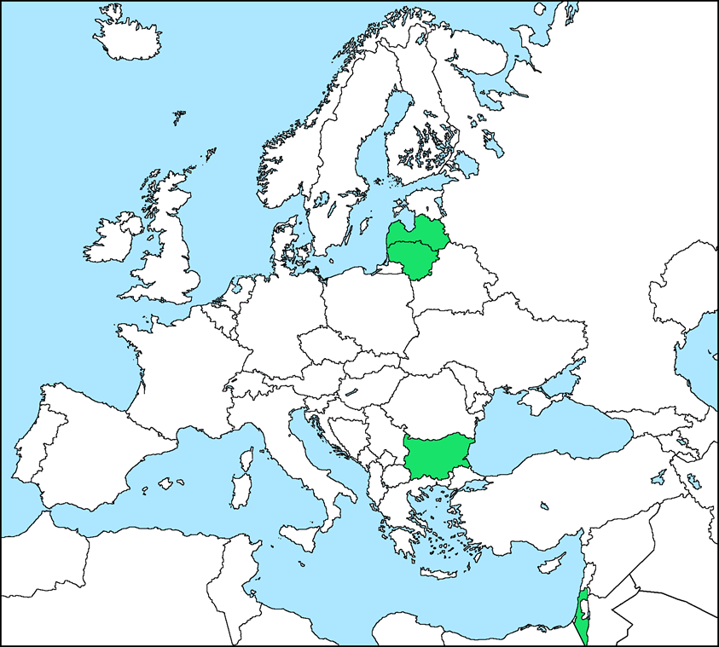

Project Partnership
Coordinator
VšĮ “eMundus“ (Lithuania)
Partners
Vytautas Magnus University (Lithuania)
Ron Vardi Center (Israel)
ISMA University (Latvia)
Zinev Art Technology - ZAT (Bulgaria)
Associated partners
Haifa Gifted University Center
IP Capital Group

Slide 3

Project context
The increasing pressure of globalization, economic competitiveness and the unsatisfactory results of students’ performance have led to increased focus on the academic achievement of gifted and talented students, who have the potential to become the innovators and leaders of the future.

Slide 4

Project context
Giftedness and talent are defined as “performance that is clearly at the upper end of the distribution in a specific talent domain even relative to other high-functioning individuals in that domain” (NAGC*) .
The students recognized to be capable of providing similar performances, but that fail to express their full potential, are referred to as “gifted underachievers”.
*National Association for Gifted Children (USA) nagc.org

Slide 5
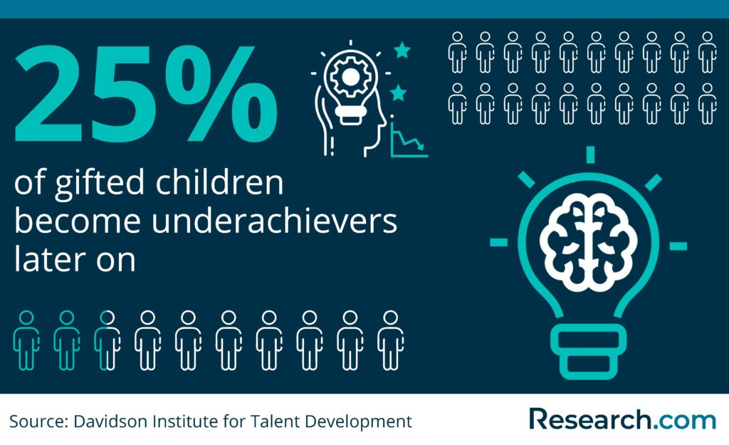
Project context
Researchers have been investigating the causes of this phenomenon, identifying such causes in the following 3 domains:
Motivation
Emotion
School perception

Slide 6
Aim
GATE project aims to enhance the competencies and skills of primary education teachers and mentors to help gifted and talented pupils (age 8-11 y.o.) develop their full potential.

Slide 7

Project objectives
To design an innovative teaching methodology for GATE pupils;
To provide a training programme for primary education teachers;
To increase the academic performance of “gate underachievers” in STEAM* subjects;
To increase awareness among school staff, public authorities, and education experts about GATE students.
*Science, technology, engineering, arts, and mathematics education

Slide 8

Target Groups
Target groups
Primary education teachers, mentors, gifted and talented pupils.
Stakeholders
Public authorities, education experts, researchers, school staff.

Slide 9

Results
Methodological material
A new teaching methodology for GATE students that will merge Socio-emotional learning and the STEAM* approach

Slide 10

Results
2. Training programme
A training programme for primary education teachers based on the methodology devised in the Gate project. It will consist of:
Theoretical basis and review of teaching practices for GATE pupils.
Teaching to GATE pupils in primary school and GATE only classes.
Evaluation and assessment tools for teachers.

Slide 11

Thank you for your attention!

